Slide 1


Unified Identity Fabric
Securing the Future of the City of Calgary
Enterprise Identity + Cloud Infrastructure + Security Monitoring
•
Microsoft Entra ID as authoritative identity provider
•
Google Workspace integration with optimized licensing
•
GCP landing zone for cloud infrastructure foundation
•
Microsoft Sentinel for unified security monitoring

Slide 2

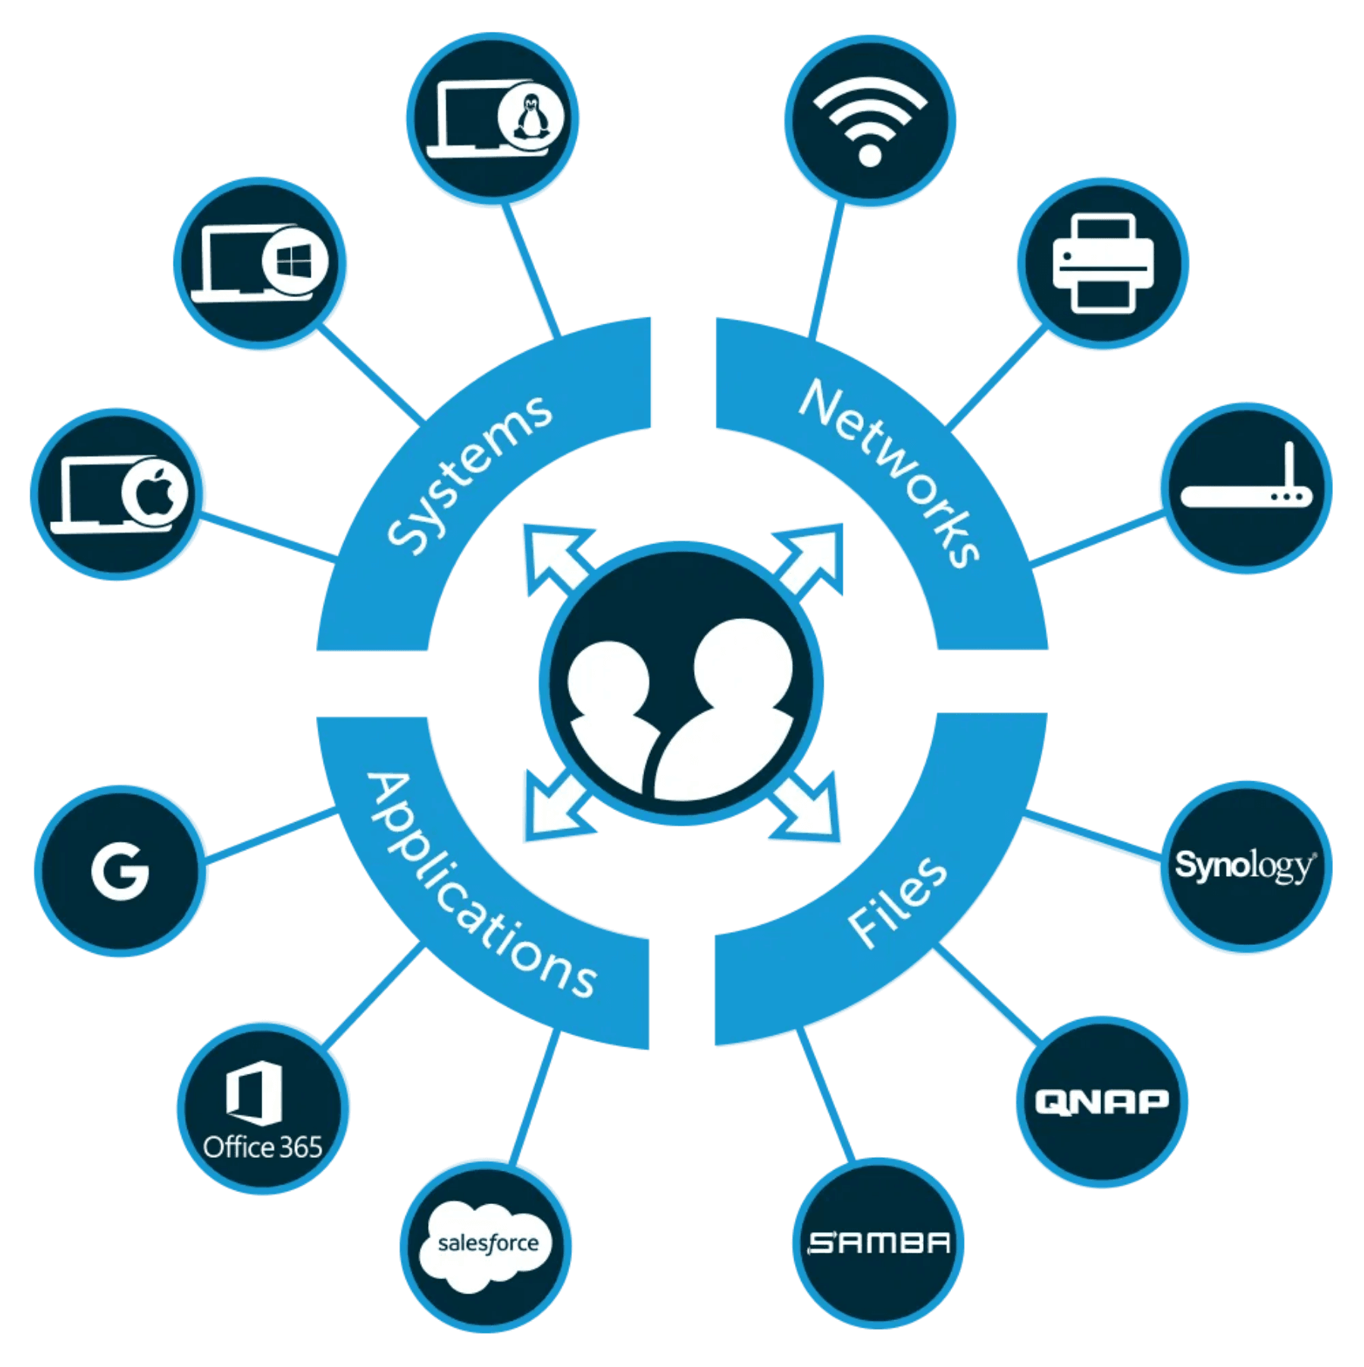
Fragmented Identity is a Security Risk and a Financial Drain
1
Increased Security Risk
Manual synchronization and multiple identity stores create a larger attack surface and compliance gaps.
2
Poor User Experience
Users face "password fatigue" and friction from managing multiple credentials for different services.
3
Unnecessary Cost
Over-licensing of full productivity suites for employees who only require access to non-productivity, SaaS, or internal applications.
The Opportunity
Consolidate identity management under a single, authoritative source (Microsoft Entra ID) to secure all applications, including the new Google Workspace environment, while implementing a surgical licensing strategy for maximum ROI.

Slide 3

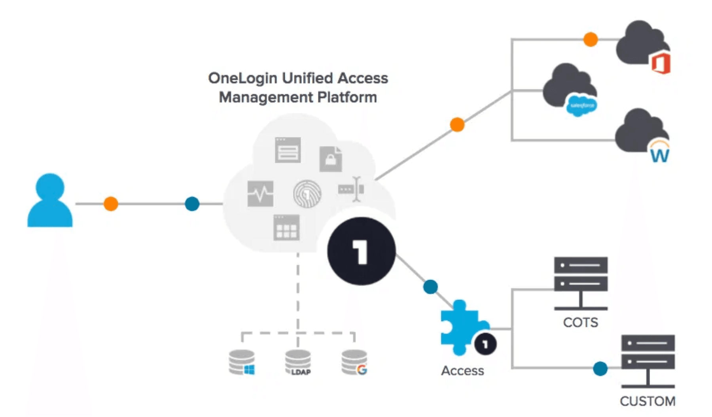
Entra ID as the Single Source of Truth for All City Services
Implement a robust, automated integration between Microsoft Entra ID and Google Workspace (via SAML and SCIM provisioning).
Centralized Control
Entra ID remains the authoritative Identity Provider (IdP) for all City users.
Automated Lifecycle
SCIM provisioning ensures real-time user creation, updates, and deactivation in Google Workspace, eliminating manual overhead and "stale" accounts.
Single Sign-On (SSO)
Seamless, secure access to all Google Workspace tools and other City applications using a single set of Entra ID credentials.

Slide 4
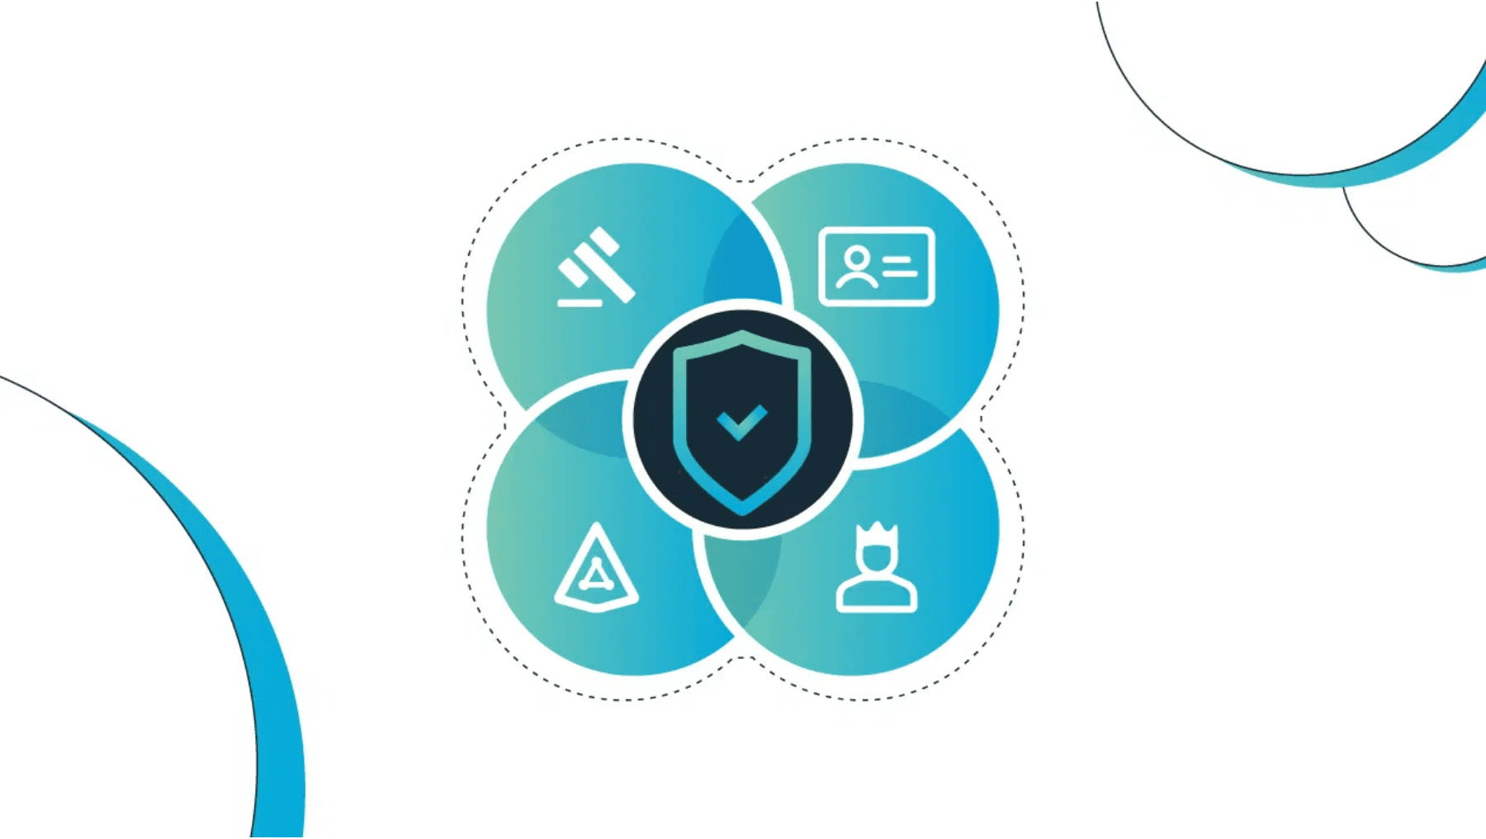
Reducing Risk Through Centralized Access Control
Zero Trust Alignment
Enforce consistent Conditional Access policies from Entra ID across all Google Workspace and third-party application access.
Rapid Deprovisioning
Immediate termination of access across all systems upon employee departure, mitigating insider threat risk.
Audit & Compliance
Centralized logging and reporting on all access events, simplifying regulatory compliance and security audits.
MFA Enforcement
Mandate Multi-Factor Authentication (MFA) from the primary IdP (Entra ID) for all services, including Google Workspace.

Slide 5
Establishing the GCP Foundation: Landing Zone Architecture
Deploy a secure, scalable GCP landing zone as the cloud infrastructure foundation, providing isolated environments, compliance controls, and seamless integration with Entra ID for unified identity across all cloud services.
Isolated Cloud Environments
Separate projects and VPCs for development, staging, and production workloads with network isolation and controlled access.
Compliance & Security Controls
Built-in security policies, encryption at rest and in transit, audit logging, and compliance frameworks aligned with City governance requirements.
Seamless Entra ID Integration
Unified identity management across GCP resources using Entra ID as the authoritative identity provider for all cloud access.
Scalable Infrastructure
Foundation for future cloud workload migration, supporting the City's long-term digital transformation and innovation initiatives.

Slide 6

GCP Foundation Benefits: Governance, Security & Operations
Governance & Accountability
Security & Resilience
Speed & Consistency
Financial Control
•
Strong governance and clear accountability
•
Improved security, resilience, and compliance
•
Reusable, opinionated Terraform modules
•
Financial control and operational insight
•
Clear cost boundaries per BU and per environment
•
Clean separation of environments (dev / non-prod / prod)
•
Hub-and-spoke network with shared VPCs
•
Automated CI/CD for infrastructure
•
Predictable landing zones for applications
•
Centralized logging and billing exports
•
Folders and projects aligned to business units
•
Standardized perimeter for all workloads
•
Predictable cost models and budget tracking
•
Org-wide security tooling (central logging, KMS)
•
Speed and consistency for delivery teams
•
Central "common" services (logging, security, KMS, secrets)
•
Built-in disaster recovery patterns

Slide 7
Driving Productivity and Reducing IT Overhead
01
02
03
Reduced Helpdesk Load
Faster Onboarding
Seamless Access
Eliminate a significant volume of password reset and account synchronization support tickets, freeing IT resources for strategic initiatives.
New employees gain immediate, secure access to all required tools upon account creation in Entra ID, reducing time-to-productivity.
A consistent, modern login experience across all platforms, improving employee satisfaction and reducing friction in daily workflows.

Slide 8

Saving Millions by Matching License to Need
The Challenge
A significant portion of the City's workforce—including first responders, field workers, and specialized app users—requires identity and access management (SSO, security) but does not require the full Google Workspace productivity suite (Gmail, Docs, Drive).
The Optimized Strategy
Google Workspace Enterprise
Cloud Identity Premium
Complete productivity suite including Gmail, Docs, Drive, Meet, and all collaboration tools. Includes advanced security controls and administrative features.
Enterprise-grade identity and access management with SSO, advanced security, device management, and Context-Aware Access—without the productivity suite.
For: Knowledge Workers & Office Staff
For: Field Workers & Specialized App Users
By leveraging Cloud Identity Premium for non-productivity users, the City achieves enterprise-grade security and unified access at a fraction of the cost of a full Workspace license for this user segment.

Slide 9

The Cost-Effective Path to Secure Identity
Feature
Google Workspace Enterprise
Cloud Identity Premium
Cost Implication
Productivity Suite
✗ Not Included
✓ Included
High Cost
(Gmail, Docs, Drive)
SSO & User Provisioning
✓ Included
✓ Included
Core Requirement Met
Advanced Security
✓ Included
✓ Included
Core Requirement Met
(Context-Aware Access)
Device Management
✓ Included
✓ Included
Core Requirement Met
Target User
Office/Knowledge Workers
Field/Specialized App Users
Significant Savings
Conclusion: By leveraging Cloud Identity Premium for non-productivity users, the City can achieve enterprise-grade security and unified access at a fraction of the cost of a full Workspace license for this user segment.

Slide 10


Enabling Targeted AI Adoption Without Over-Licensing
The Gemini Challenge
Gemini for Google Workspace is an add-on to a full Workspace license. Licensing all non-productivity users with Workspace just for potential AI access is cost-prohibitive.
The Optimized Solution
Workspace Users
Seamlessly adopt Gemini for Workspace as an add-on for knowledge workers.
Cloud Identity Users
For specialized roles (e.g., data science, planning) that require AI but not the full suite, we will procure Gemini Enterprise licenses only for those specific users. This avoids the cost of a full Workspace license while still enabling critical AI-powered workflows.
Strategic Outcome
We enable targeted, high-value AI adoption across the City while maintaining strict cost control over the underlying identity licenses.

Slide 11


Securing a Strategic Investment for Maximum Annual Return
Investment Ask
Project Cost
$[500K–750K]
Implementation Costs
Consulting, Integration, IT Resources
Timeline
6–9 Months
Projected Annual Savings
Current Cost (Full Workspace)
Optimized Cost (Workspace + Cloud Identity)
$[2.0M]
$[1.2M]
Annual Savings
Year 1 ROI
$[800K]
160%
Payback Period
< 9 Months
The project investment is fully recovered through licensing optimization within the first year of full deployment.
Beyond Financials: Significant, unquantifiable returns in security posture, compliance, and employee productivity.

Slide 12


Your Decision Today Secures Our Digital Tomorrow
We request C-Suite approval and funding for the Unified Identity Fabric Project
1
Secure Funding
Final approval of the investment to launch the integration project.
2
Vendor Selection
Finalize selection of integration partners and implementation teams.
3
Pilot Program
Launch a focused pilot with a high-value user group to validate the model and ROI.
The time to act is now to eliminate risk and unlock significant operational savings.

Slide 13
Real-Time Security Monitoring: Microsoft Sentinel Integration
Centralize security monitoring by streaming logs from GCP Cloud Logging to Microsoft Sentinel, enabling unified threat detection, incident response, and compliance reporting across identity systems, cloud infrastructure, and applications.
Unified Log Aggregation
Threat Detection & Response
Collect and correlate logs from Microsoft Entra ID, Google Workspace, GCP Cloud Logging, and other City systems in a single, searchable repository for comprehensive visibility.
Leverage Sentinel's AI-powered analytics and threat intelligence to detect anomalous behavior, suspicious access patterns, and potential security incidents in real-time.
Compliance & Audit Reporting
Proactive Security Intelligence
Automated compliance reporting for regulatory requirements (PIPEDA, SOC 2) with detailed audit trails and forensic capabilities for security investigations.
Continuous monitoring and alerting on security events, enabling rapid incident response and reducing mean time to detection (MTTD) and resolution (MTTR).
Integration Architecture
GCP Cloud Logging Captures all activity and events from GCP resources, Entra ID, and integrated applications
→
Microsoft Sentinel Aggregates, analyzes, and correlates logs for unified security monitoring and threat detection
→
Security Operations Enables rapid incident response and compliance reporting

